Slide 1
An Introduction to MonetDB
Lingbin Ni
July. 27, 2017

Slide 2
Features
Column-store
最大的特点是方便存储结构化和半结构化数据，方便做数据压缩，对针对某一列或者某几列的查询有非常大的IO优势。
CPU-tuned query
提高查询速度。
In-memory optimized
数据超过内存和虚拟内存，才使用磁盘存放文件。
Notes:
2

Slide 3
Installation(Windows)
1. Login: https://www.monetdb.org/downloads/Windows/.
2. Download MonetDB installers including the MonetDB5/SQL installer, the Geometry module and the ODBC driver.
3. The Geometry module requires the MonetDB5/SQL installer to be installed first. The ODBC driver can be installed separately.
4. Firstly, you should initialize a MonetDB server by simply opening: 'Start -> Programs -> MonetDB -> Start server'. Subsequently, you can start the mclient by opening: 'Start -> Programs -> MonetDB -> SQL client'.

Slide 4
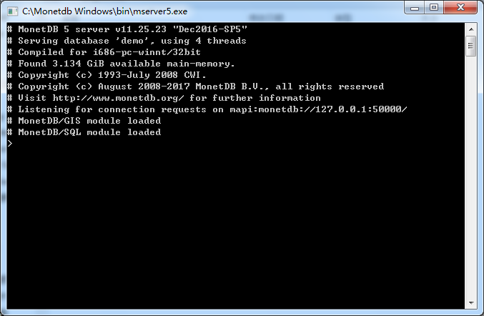
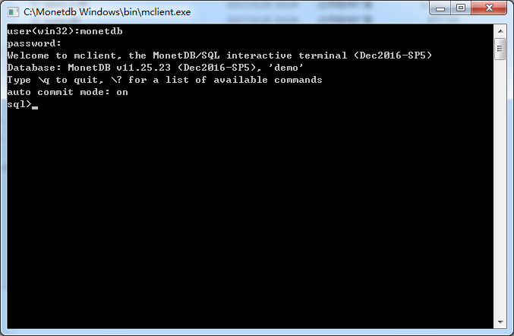
Installation(Windows)

Slide 5
Installation(Linux)
Install Ubuntu-16.04
Ubuntu-16.04系统有桌面和窗口操作，风格类似Mac系统。当然，我们同样可以调用Bash进行操作。详情参考我写的教程：
Linux双系统安装教程.docx
2. Install MonetDB for Ubuntu & Debian
https://www.monetdb.org/downloads/deb/

Slide 6
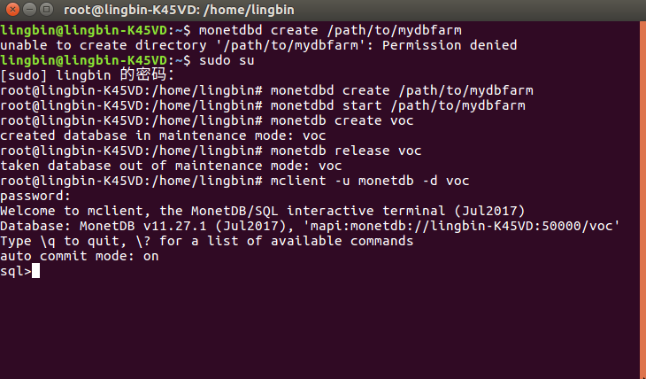
Installation(Linux)

Slide 7
Database Management
MAL
MonetDB Assembly Language(MAL)
MAL是SQL和XQuery前端查询的目标语言。
SQL语句通过语法解析解析成MAL，MAL再经过优化器优化，重写成优化后的MAL，提供给内核执行。

Slide 8
Database Management
SQL功能 | 动词
数据查询 | SELECT
数据定义 | CREATE,DROP,ALTER
数据操纵 | INSERT,UPDATE,DELETE
数据控制 | GRANT,REVOKE

Slide 9
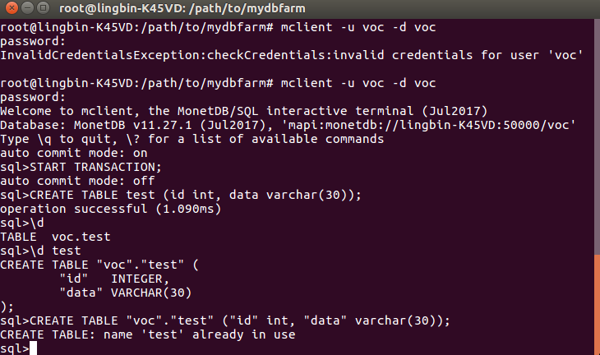
Database Management

Slide 10
Thanks!

